Slide 1
Capstone Project
Airbnb Bookings Analysis
Individual Project By:
Nishank Rana
Email - nr9556@gmail.com
Contact no. 8439360929
Github Commit :- https://github.com/NishankRana

Slide 2

Points For Discussion
Airbnb?
Data Summary
Problem Statement
Correlation Check
Total Hosts Listings
Visitors and Reason
Maximum Price Per Night
Minimum Price Per Night
Top 10 Busiest Hosts
Traffic Areas
Why Manhattan?
Conclusion

Slide 3


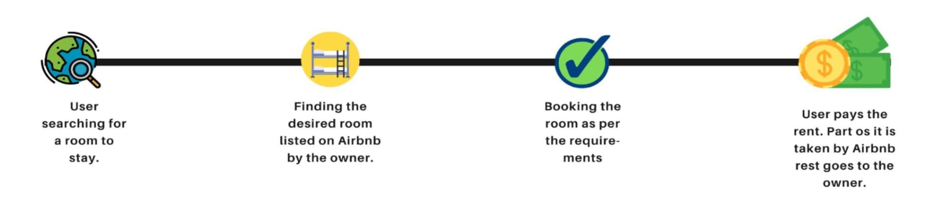
Airbnb?
Airbnb has an interesting breakdown with names likely: Air, Bed and Breakfast to become Airbnb. Since its founding, Airbnb has hosted over 60 million people in 34,000 cities across the world and is continuing to grow quickly. Airbnb is an online marketplace or a platform that connects people who want to rent out their Homes, Apartments and Private rooms with people who are looking for accommodations in that locale. New York City is the most densely populated city in the United States, and one of the most popular tourism and business places globally. Airbnb provides a convenient source of income for people who have otherwise vacant space and for guests looking for affordable and convenient housing options. With any service, trying to monitor and understand the underlying pricing dynamics of the Airbnb market is very important both for hosts and guests. As users continue to grow on both the supply and demand side, homeowners may find it hard to properly price their property. Airbnb has recognized this and conducted considerable research into suggesting pricing from a supply side standpoint.
How does it operate?

Slide 4
Data Summary
df : It contains all the information such as id, name, host id, host name, neighbourhood group, neighbourhood, latitude, longitude, room type, price, minimum nights, number of reviews, last reviews, reviews per month, calculated host listings count and availability 365.
Total number of rows and columns are 48895 and 16 respectively.
We will not use the column names such as “latitude” and “longitude” in our analysis. Because it only contains the geographical coordinates of Airbnb which we already have in the form of column name “Neighbourhood_group”.

Slide 5
Problem Statement
For this project we have analyzed Airbnb’s New York City(NYC) data of 2019. NYC is not only the most famous city in the world but also the top global destination for visitors drawn to its museums, entertainment, restaurants and commerce.
Our Main objective is to find out the key metrics that influence the listing of properties on the platform. For this, we explore and visualize the dataset from Airbnb in NYC using EDA ( Exploratory Data Analysis).
Data analysis on thousands of listing provided through Airbnb is a crucial factor for the company.
We will be finding out the distribution of every Airbnb listings based on their location in NYC, including their price range, room type, listing name and other related factors.

Slide 6
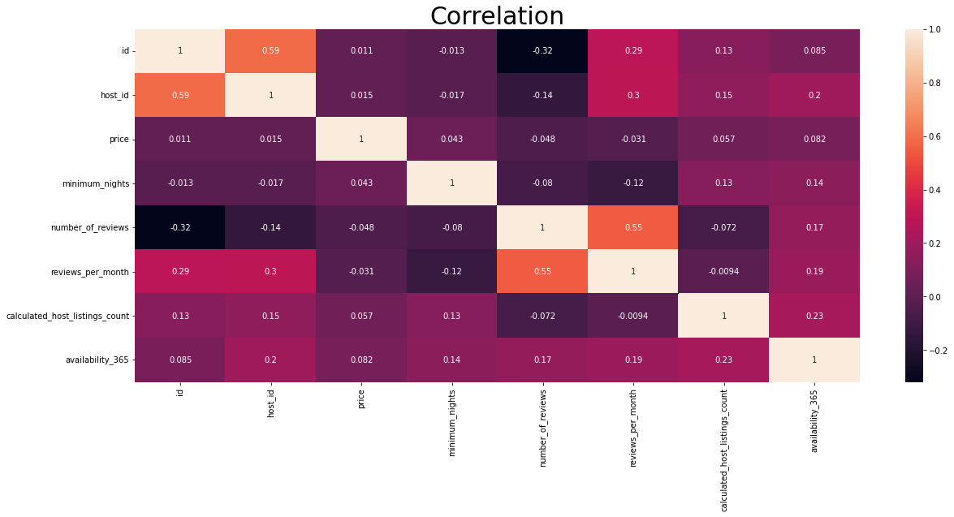
Correlation Check
It’s difficult to understand the heatmap at first glance, so let’s break it down.
If the color of the box moves towards grey the features are positively correlated, if moving towards green then negatively correlated.
While building a model positive correlation is preferred whereas the variables with negative correlation are dropped.
This helps a lot to understand
the data and selecting the
required features.

Slide 7
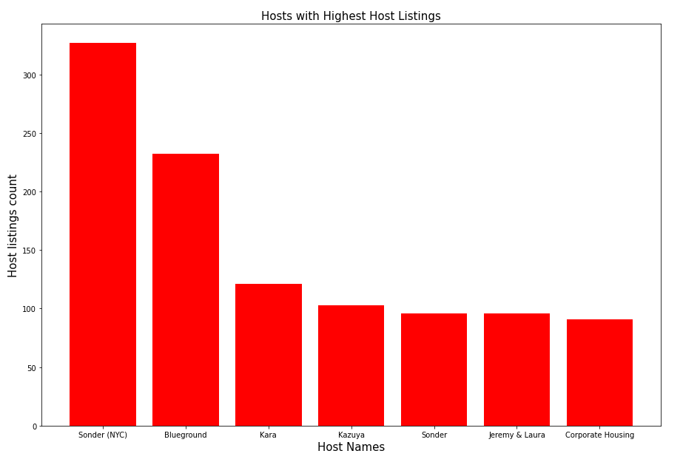
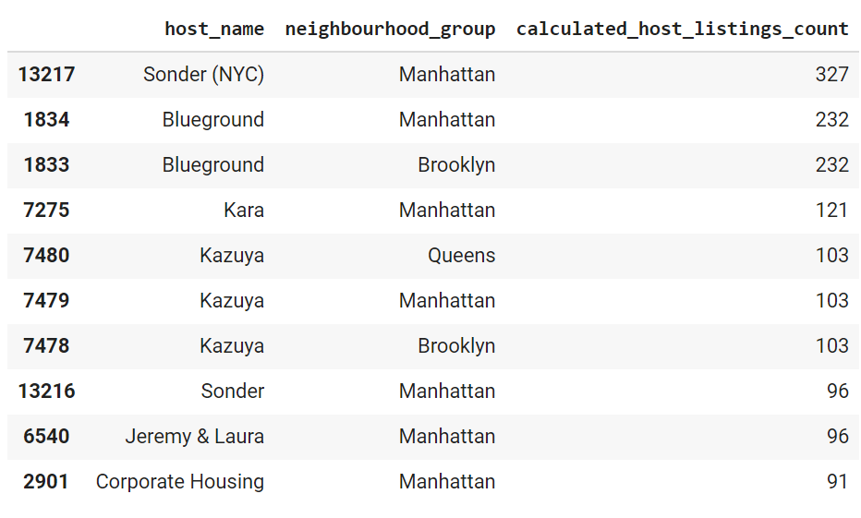
Top Hosts Listings
The Manhattan neighbourhood group has maximum number of listings, Which is 327 exact by the host name Sonder(NYC).

Slide 8
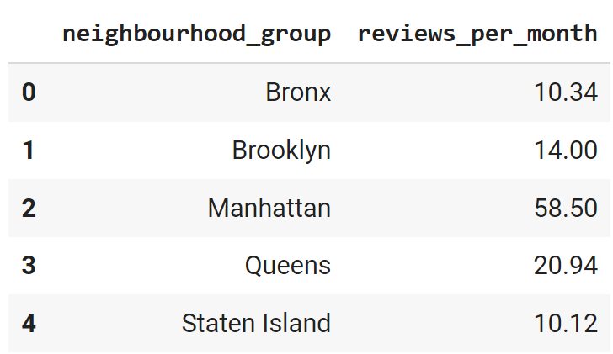
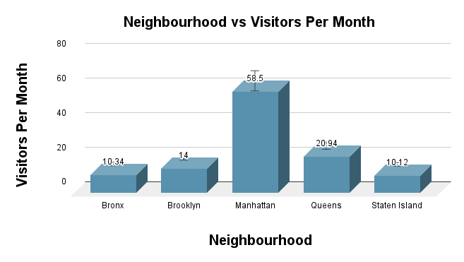
Visitors
Visitors on monthly basis
Manhattan neighbourhood group has more number of visitors per month.
Queens has the second highest number of visitors.

Slide 9
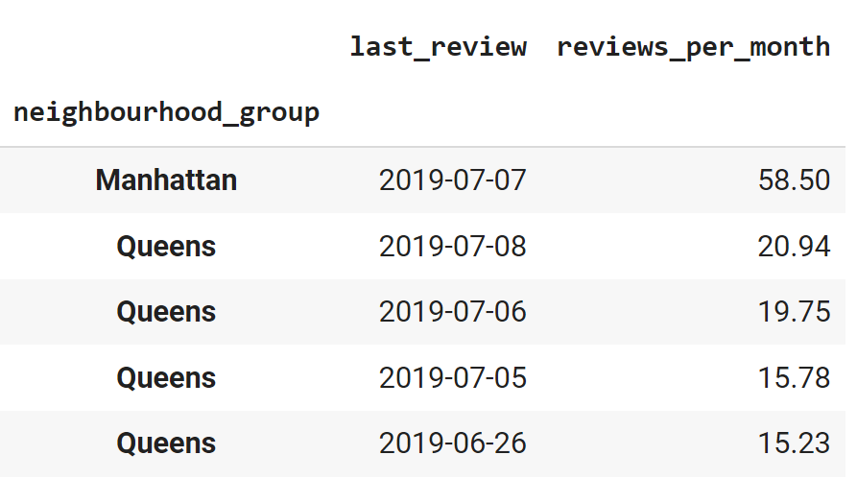
Reason
We got last review date of Manhattan neighbourhood which is 7th of July 2019.
The reasons behind why we get Manhattan on top in July month.
Fourth of July is the independence day of America. On this day there is a federal
holiday across the entire America.

Slide 10
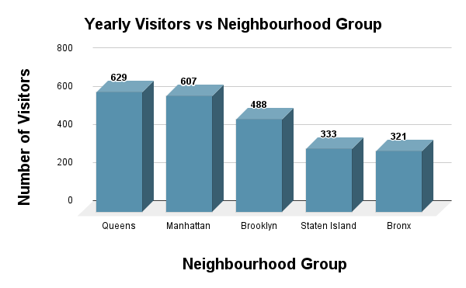
Visitors on yearly basis
Things changed when we saw yearly Visitors.
Queens neighbourhood group has got a little bit more number of visitors, which is 629.
Manhattan got the second highest number of visitors.
Following might be the reason behind this result :-
Queens is famous for studies, social science and mental health research and highlighted by the 2015 Nobel Prize in Physics. So might be student was came here for admission/Intake purpose throughout the year.

Slide 11
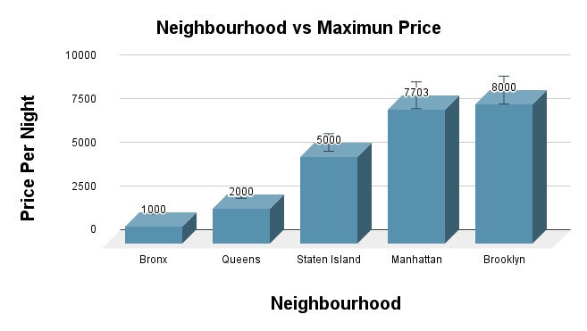
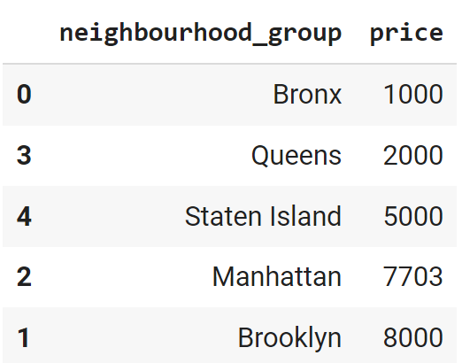
Maximum Price Per Night
We can see that Brooklyn and Manhattan neighborhood groups has high price tagged Airbnb which costs more than 5000$ per night.
Reason :- Brooklyn and Manhattan are metropolitan cities. These cities are heavily densely populated. These neighborhood comes under the Porsche area. Most of the trade happens there.

Slide 12
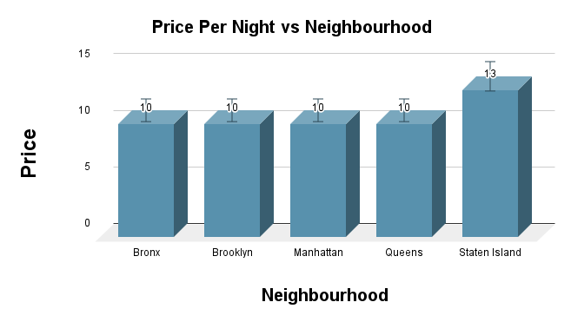
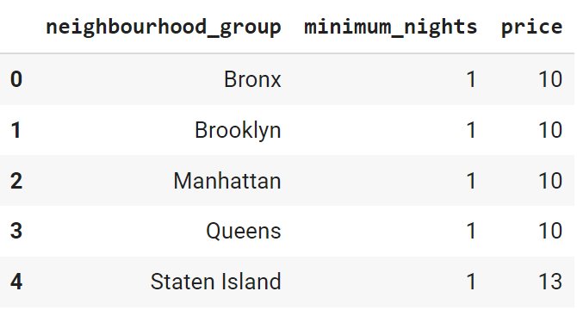
Minimum price Per Night
Bronx, Brooklyn, Manhattan and Queens has lowest price tag Airbnb.
But Staten Island offering Airbnb at 13 $ which is the lowest in this neighbourhood.

Slide 13
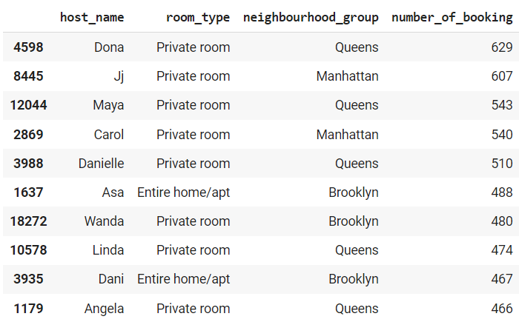
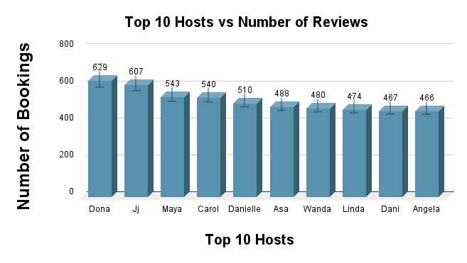
Top 10 Busiest Hosts
Following are the top 10 Busiest Hosts in 2019 :-

Slide 14
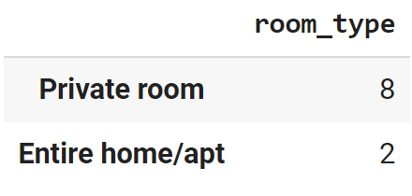
Reason why these are the top 10 host
In the below dataset we can see that 8 out of 10 hosts has similar room type which is “Private Room”.
Rest of 2 has “Entire home/Apartment” as room type.
So, the key to being the busiest host is..
Airbnb whose room type is private room would be the busiest hosts.

Slide 15
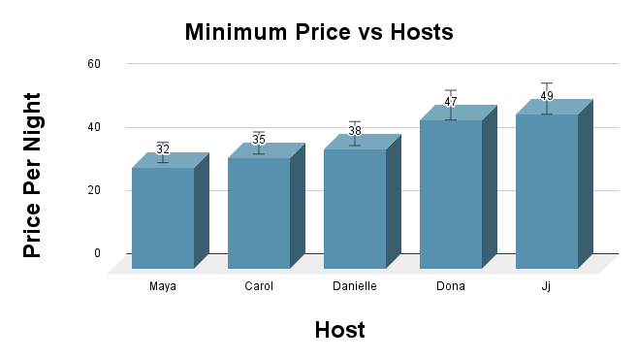
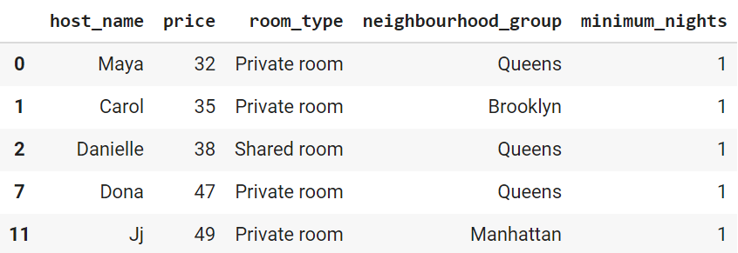
Price Per Night Offer By Top Hosts
Following are the Top 5 hosts whose Airbnb price are minimum as compared to others.
Maya offers private room in Queens neighbourhood at price 32 per night.
Carol offers private room in Brooklyn neighbourhood at price 35 per night.
Danielle offers private room in Queens neighbourhood at price 38 per night.
Dona offers private room in Queens neighbourhood at price 47 per night.
Jj offers private room in Manhattan neighbourhood at price 49 per night.

Slide 16
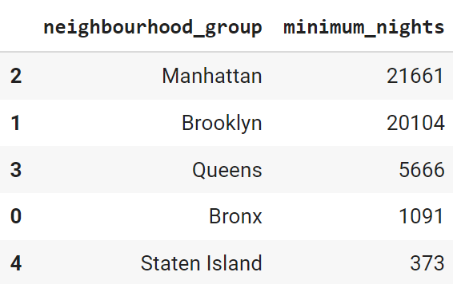
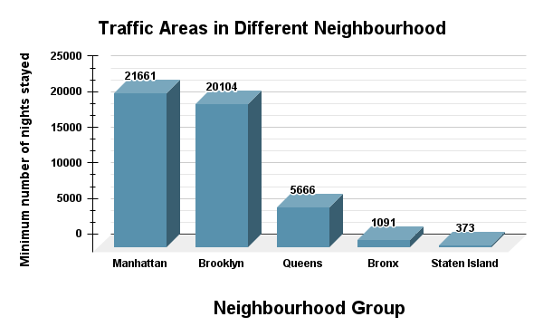
Traffic Areas
Manhattan neighbourhood has The most traffic as compared to other
neighbourhoods

Slide 17
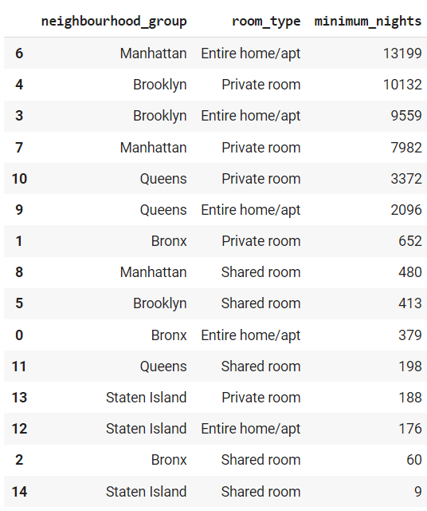
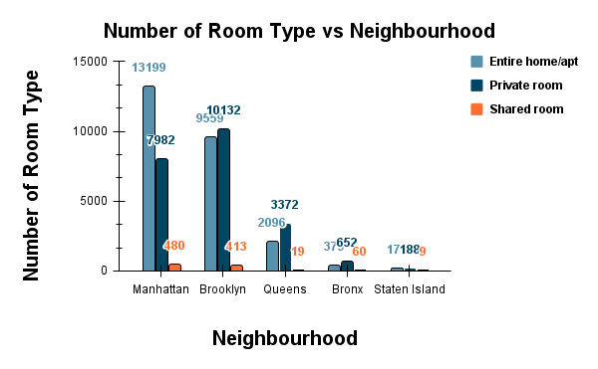
Why Manhattan?
Why does Manhattan has more traffic as compared to others? Because Manhattan is a metropolitan area and has more historical places. The number of Airbnb listings is also high there. In which Entire home/Apartment are the highest number of room type listings.

Slide 18
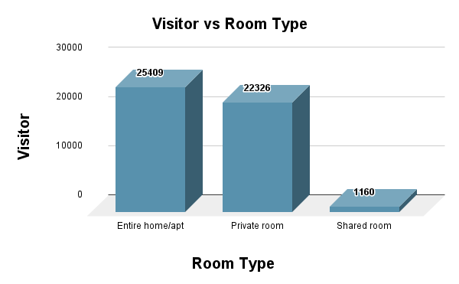
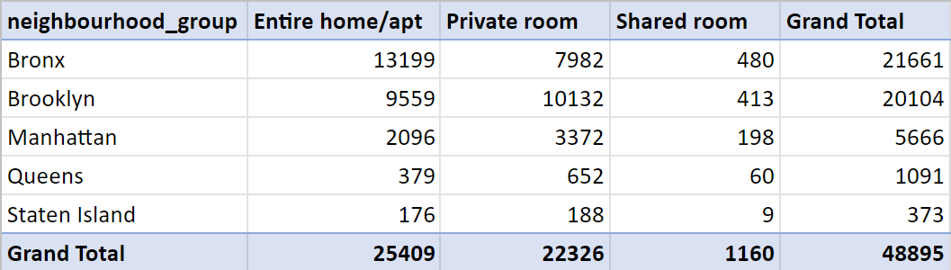
What kind of room type people prefer more in traffic areas?
People prefer to stay in an Entire Home/Apartment as room type.
Reason
Visitors would love to travel with their family. That’s why they book
Entire home/Apartment as room type.

Slide 19
Conclusion
The Manhattan neighborhood has the most listed Airbnb as compared to others.
Queens and Manhattan has the most number of visitors which means people visited more here.
In the month of July people visited more in manhattan.
Brooklyn and Manhattan have a maximum price which costs more than 5000 because of the metropolitan city.
The Bronx neighborhood has their maximum price Airbnb which costs 1000 per night.
The top 5 hosts have listed their Airbnb which has room type as private.
The major traffic areas are where rooms type as entire home/apartment and private room.
Peoples don't like to stay in Airbnb which has room type as shared room.
The demand of Airbnb is too high in Manhattan and Queens neighborhoods.
In Staten Island the demand of Airbnb is too low as compared to others neighborhoods.
In Staten Island the lowest price tagged Airbnb 13 is a little bit higher than other neighborhoods and the maximum price for single night is 5000.
In the Staten island neighborhood the pricing of the Airbnb is quite high. Therefor people doesn’t book Airbnb there.
It would be better to record the reviews on the scale of 0 to 5. It will help to identify the hosts whose services are better.

Slide 20
Challenges Faced
Interpretation of all features and deciding which ones will be helpful in our analysis.
Understanding the dataset and deciding what features we can convert into categorical features, apart from the existing categorical features.
Handling NaN values for last_reviews features.
Filtering out important trends and visualizations from the unimportant ones.
Choosing the type of visualization to convey data in a better way.

Slide 21
THANK YOU

